Slide 1
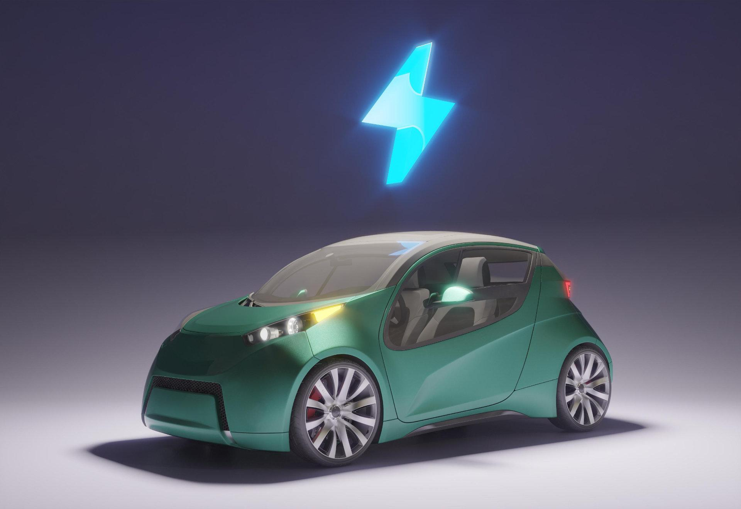
Autonomous Vehicles
The Future is autonomous.

Slide 2
TABLE OF CONTENTS
01
02
03
04
05
06
ABOUT THE PROJECT
MAJOR REQUIREMENT
PROJECT GOALS
AI-powered transportation without human drivers
Sensors, cameras, AI, mapping technology, connectivity.
Efficient and safe autonomous transportation systems.
SNEAK PEEK
PROJECT STAGES
OUR TEAM
Reconstructed transportation with self-driving cars
Research, development, testing, deployment, regulation.
Experts in autonomous vehicle technology development.

Slide 3
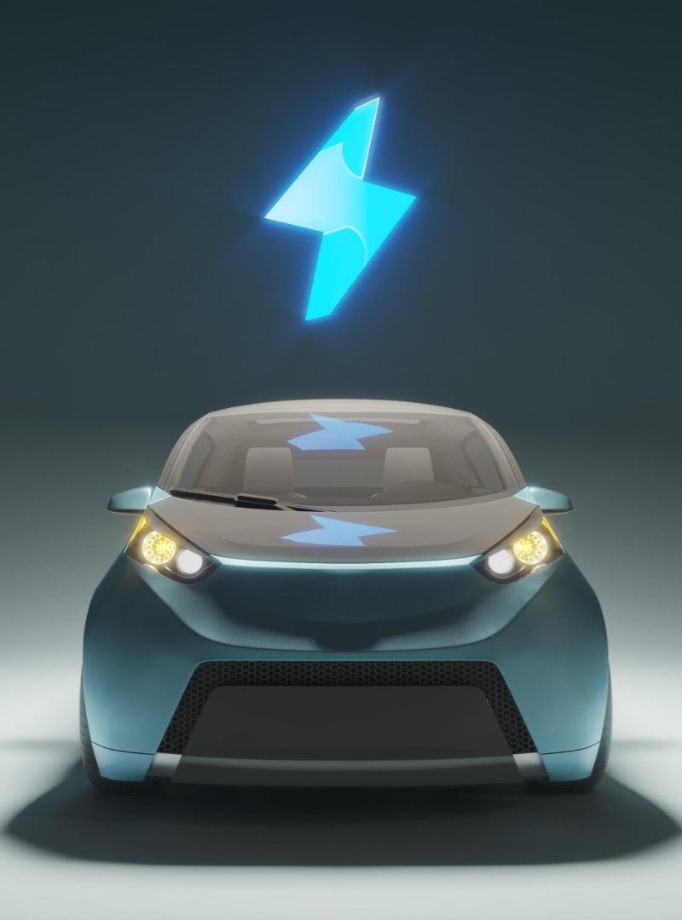
01
ABOUT THE PROJECT
Redefining Transportation: Autonomous Vehicle Solutions.

Slide 4
what is Autonomous Vehicle?
An autonomous vehicle, also known as a self-driving car or driverless car, is a vehicle that can sense its environment and navigating without human input. These vehicles use a combination of sensors, cameras, GPS, and machine learning algorithms to understand their surroundings and make decisions on their own.

Slide 5
Cloud Computing
01
02
03
Scalability :
Cost savings :
Accessibility :
Cloud resources can be easily scaled up or down to meet changing demands.
Cloud computing eliminates the need for costly hardware and infrastructure, and users only pay for the resources they use.
Cloud resources can be accessed from anywhere

Slide 6
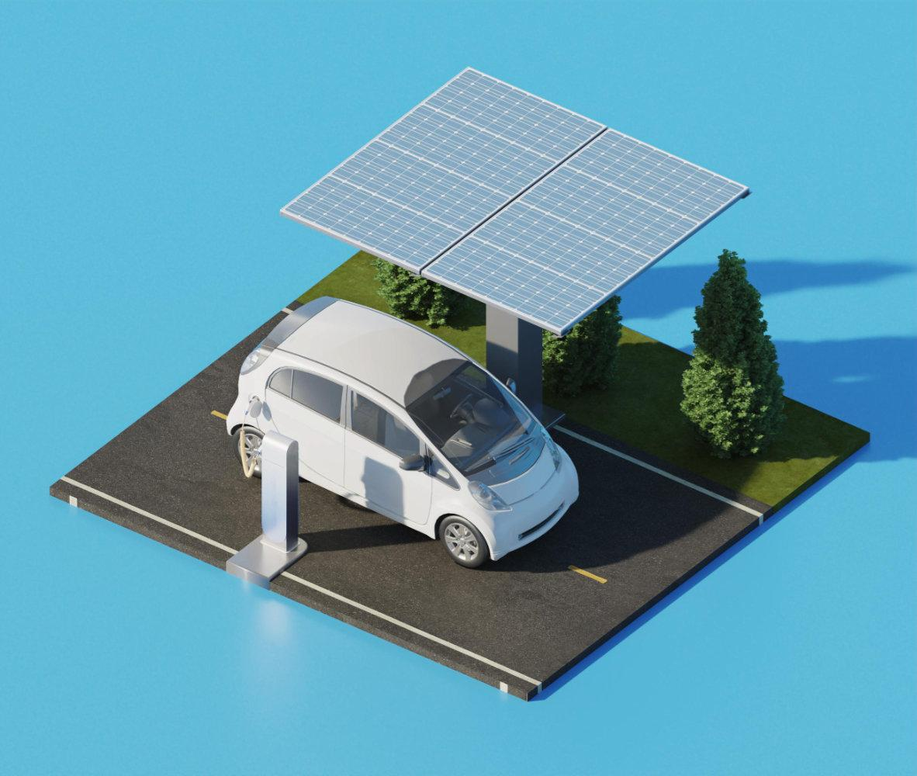
Autonomous Vechiles
Autonomous vehicles are vehicles that can operate without a human driver, using technologies such as sensors, cameras, and GPS. They have advanced computer systems and algorithms that allow them to navigate traffic, recognize road signs and obstacles, and communicate with other vehicles and infrastructure. These vehicles have the potential to increase safety, reduce traffic congestion, and increase mobility for people who cannot drive.

Slide 7
— Bill Ford, executive chairman of Ford Motor Company.
"Autonomous vehicles will revolutionize transportation and make our roads safer."

Slide 8
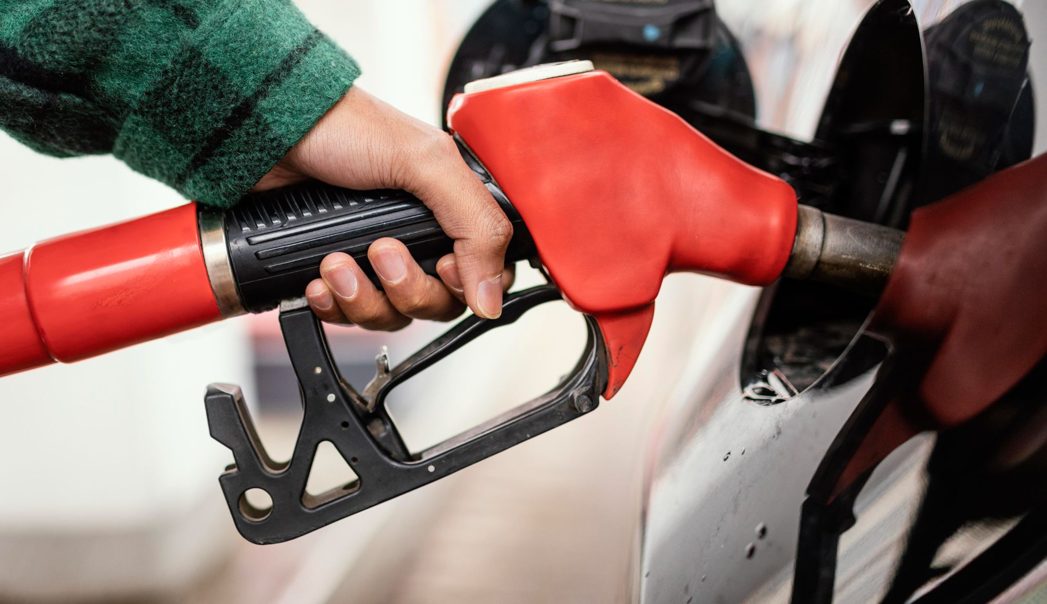
NOW
Autonomous vehicles are being developed and tested globally, with some already in use for specific purposes such as self-driving taxis and delivery trucks.

Slide 9
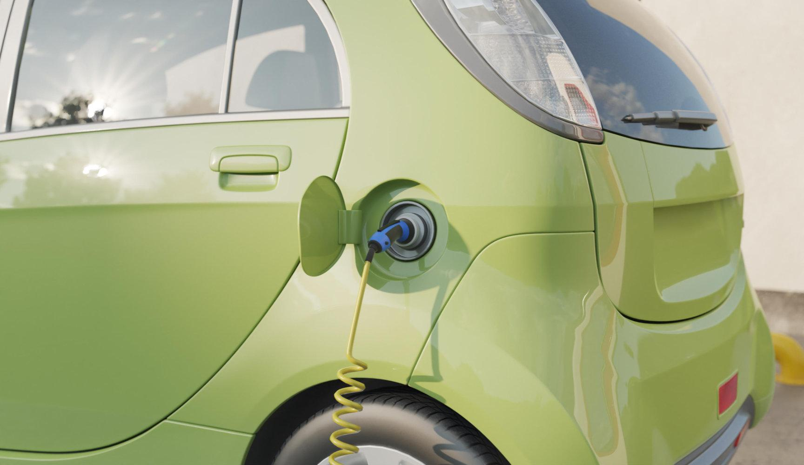
FUTURE
The future of autonomous vehicles is promising, with the potential to transform transportation and have a significant impact on society.

Slide 10
MAJOR REQUIREMENTS
Robust communication and networking
Advanced sensors and perception systems
Artificial intelligence and machine learning
Cybersecurity and Data privacy

Slide 11
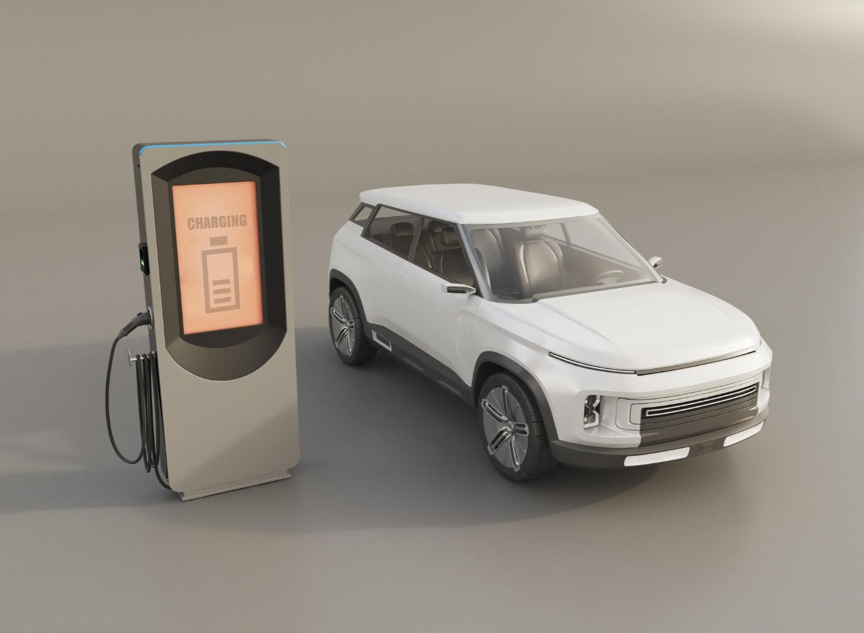
Lets go AI !
Artificial intelligence is the new electricity.

Slide 12
Welcome to the New Normal

Slide 13
OUR TEAM
Divesh Adivarekar
Prem Patil

Slide 14
Thank You
DOES ANYONE HAVE ANY QUESTIONS?
https://diveshwebsite.000webhostapp.com/paper.html

